Slide 1
Project 05
Description
The objective of this project is to use the Azure portal to create a public Azure Load Balancer, configuring it to manage a backend pool containing two virtual machines. Additionally, set up Azure Bastion, a NAT Gateway, a virtual network, and necessary subnets to support the load balancer configuration.

Slide 2
Business Problem Statement and Prerequisites
Business problem statement
Growing e-commerce platform: Experiencing significant upticks in traffic during peak hours, indicating increasing demand.
Performance issues and downtime: Resulting from the inability to handle surges in traffic effectively, leading to degraded user experience.
Requirement for robust load balancing: Across multiple servers to evenly distribute incoming requests and maintain high availability and scalability.
Pre- requisites
An Azure account with an active subscription.

Slide 3
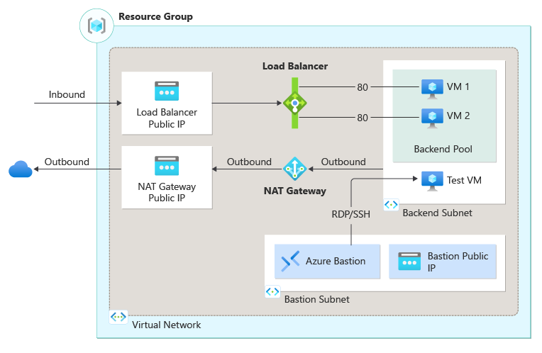
High-Level Architecture:

Slide 4
Load balancing process for Azure VMs and Helpful documents
Establish a NAT gateway to enable outbound internet access for resources within the virtual network.
Set up a virtual network featuring a resource subnet alongside Azure Bastion subnet and host.
Deploy a zone-redundant load balancer for distributing load across virtual machines.
Create two VMs, "lb-vm1" and "lb-VM2," in distinct zones - Zone 1 and Zone 2.
Install IIS on both VMs to ensure proper functionality.
Conduct testing of the load balancer to verify its effectiveness.
Helpful documents
https://learn.microsoft.com/en-us/azure/load-balancer/quickstart-load-balancer-standard-public-portal

